Slide 1
There’s a place for students who love math…and for those who fear it.

Slide 2
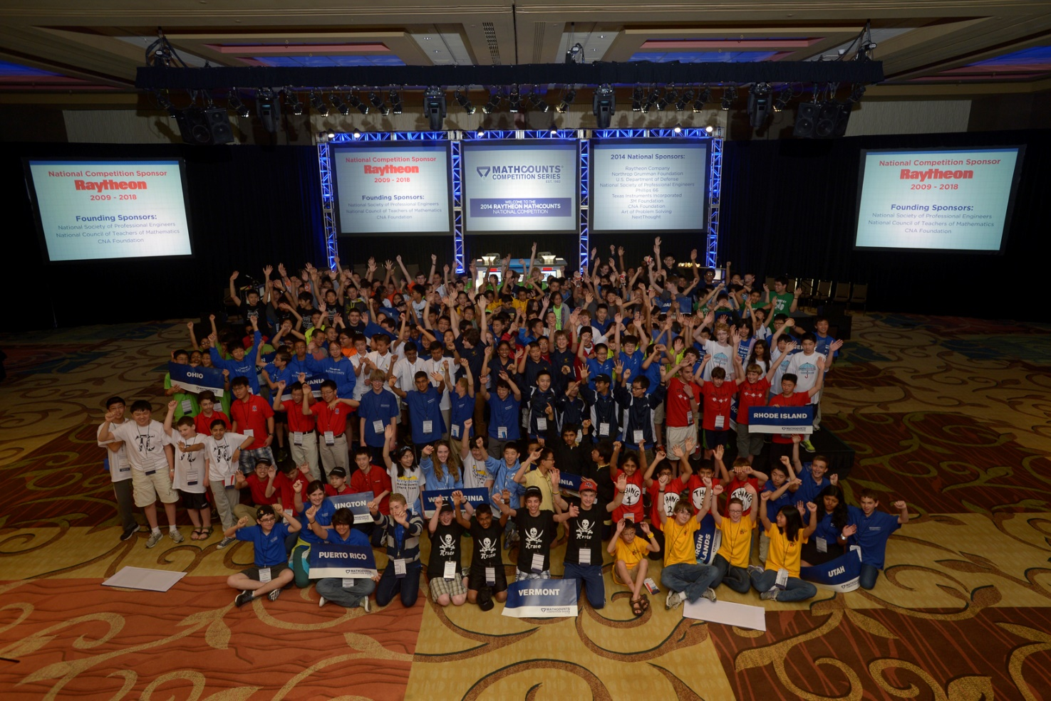
OUR MISSION: to provide engaging math programs for U.S. middle school students of all ability levels to build confidence and improve attitudes towards math and problem solving.

Slide 3
THREE DISTINCT PROGRAMS:

Slide 4
The MATHCOUNTS Competition Series is the premiere math competition for middle school students in the United States.
With live events in over 500 locations every year, MATHCOUNTS is the only nationwide competition that brings students together to compete
in-person in math.

Slide 5
1 National Champion is crowned during the Countdown Round of the National Competition, webcast on ESPN
224 stellar students earn an all-expenses-paid trip to the National Competition in May
State Competitions are held in 56 states
and U.S. territories in March
40,000 students advance to one of 500 inter-school Chapter Competitions in February
100,000 students in over 5,300 schools take part in intra-school competitions
48,000 U.S. middle schools receive free curriculum materials every year

Slide 6
The National Math Club is designed to provide the structure, resources and incentives to make it easy for any teacher to run their own math club.
This program is completely free (no catch!) and designed for students of all ability levels in math. Multiple teachers from the same school can sign up.

Slide 7
National Math Club Membership: Teacher enrolls math club.
Club receives: Club in a Box, recognition on website
Silver Level Club: Club meets a minimum number of times during the year.
Club receives: Trophy, certificates, entry into drawings for $250 gift cards for club
Gold Level Club: Club completes a Gold Level Project that involves a minimum number of students.
Club receives: Banner, certificates, entry into drawings for $500 gift cards and trip to Raytheon MATHCOUNTS National Competition

Slide 8
The Math Video Challenge provides students the opportunity to put their 21st century skills of communication, creativity and teamwork together to create their own math video.
It is free to participate (no catch!) in this program, and it provides a great way to incorporate project-based learning into your instruction.

Slide 9
Student teams create a video that teaches a problem from the MATHCOUNTS School Handbook and post to videochallenge.mathcounts.org
General public votes on best videos; top 100 advance to judging rounds
Judges panel selects 20 semifinalist videos
Judges panel reviews semifinalists and selects 4 finalist videos
Finalists present their videos to the 224 Mathletes® competing in the Raytheon MATHCOUNTS National Competition, and the Mathletes® select the overall winner
Free website archive of student-created videos (all cross-referenced by difficulty level, domain, and Common Core Standard) becomes an educational tool

Slide 10
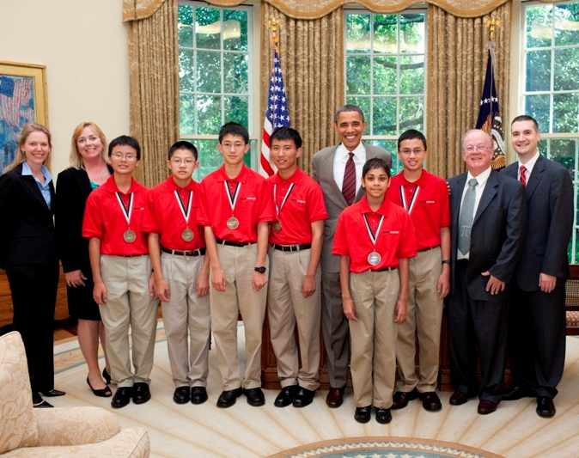
CONTACT:
The MATHCOUNTS Foundation
1420 King Street
Alexandria, VA 22314
Tel: (703) 299-9006
Fax: (703) 299-5009
Email: info@mathcounts.org
www.mathcounts.org

